Slide 1
Lecture 7: Customer Relationship Management (CRM) and Dimension Patterns
Chapter 8

Slide 2
Customer Relationship Management
The better you know your customers, the better you can maintain long-lasting, valuable relationships with them.
The goal of CRM is to maximize relationships with your customers over their lifetime.
Entails focusing all aspects of the business: marketing, sales, operations, and service, on establishing and sustaining mutually beneficial customer relations.
Develop a single, integrated view of each customer.

Slide 3
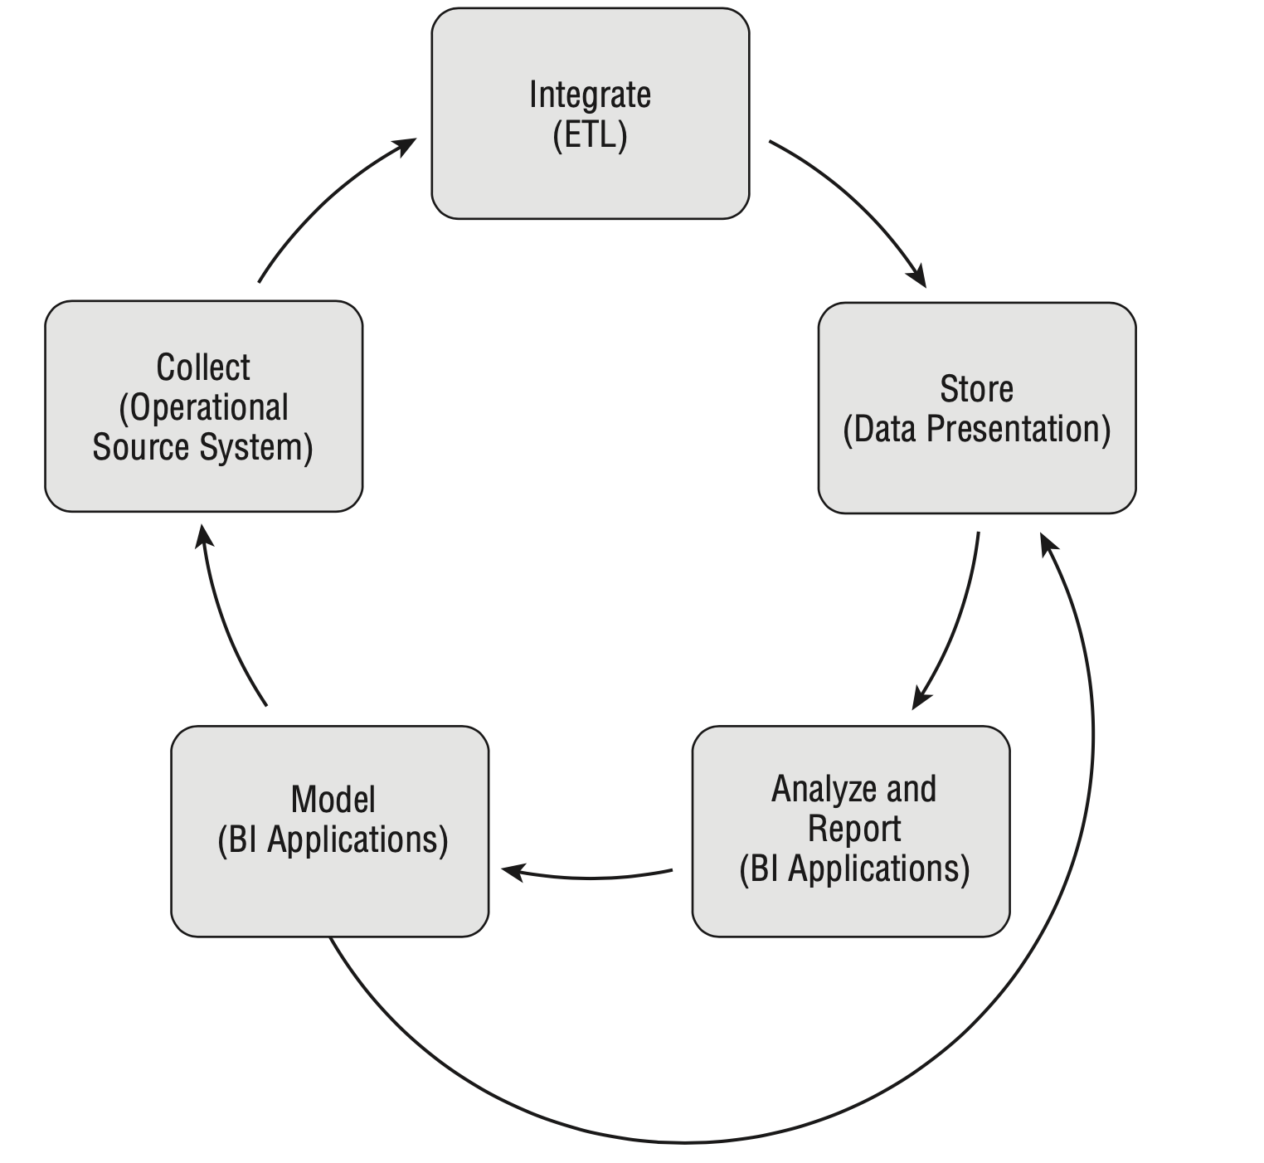
Operational and Analytic CRM
Operational CRM: All the customer interactions that occur during the purchase and usage of a product or service, from the initial prospect contact, quote generation, purchase transaction, fulfillment, payment transaction, and on-going customer service.
Analytic CRM: enabled via accurate, integrated, and accessible customer data in the DW/BI system.

Slide 4
Customer Dimension Attributes
The conformed customer dimension is a critical element for effective CRM;
In a large organization, the customer dimension can be extremely deep (with many millions of rows), extremely wide (with dozens or even hundreds of attributes), and sometimes subject to rapid change.
The customer dimension often represents an amalgamation of data from multiple internal and external source systems.

Slide 5
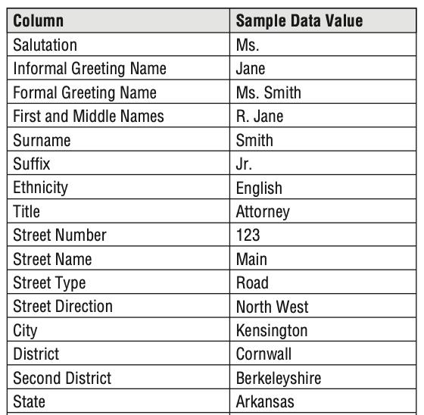
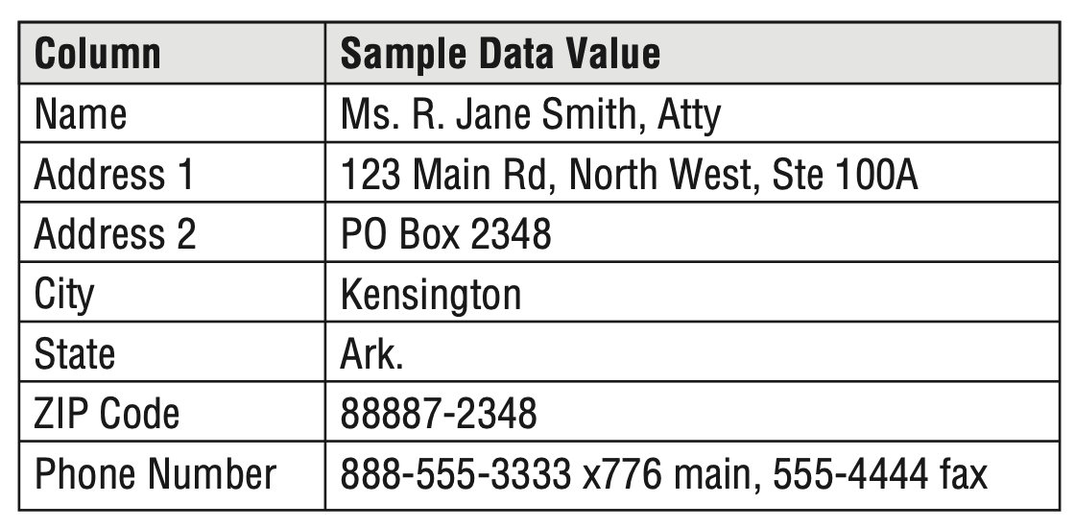
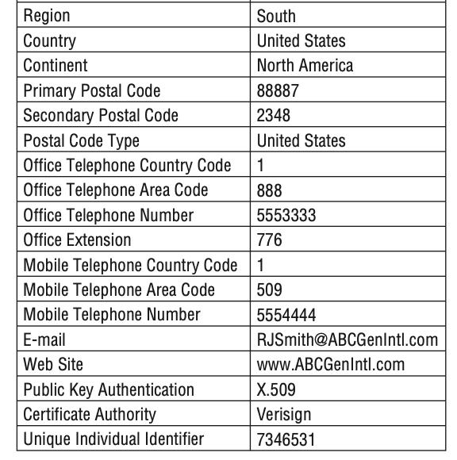
Name and Address Parsing
Address data with parsed name and address elements
Address data in overly general columns

Slide 6
Aggregated Facts as Dimension Attributes
Business users are often interested in constraining the customer dimension based on aggregated performance metrics, such as ﬁltering on all customers who spent over a certain dollar amount during last year or perhaps over the customer’s lifetime.
Selected aggregated facts can be placed in a dimension as targets for constraining and as row labels for reporting.
The metrics are often presented as banded ranges in the dimension table.

Slide 7
Bridge Tables for Multivalued Dimensions
How to handle multiple values at the grain of the individual transaction:
Professional skills of a job applicant
Hobbies of an individual
Diagnoses or symptoms of a patient
Optional features for an automobile or truck
Joint account holders in a bank account
Tenants in a rental property
A positional design: individual dimension, fast query, less scalable;
Bridge table design: complex query, no direct view by the business user

Slide 8
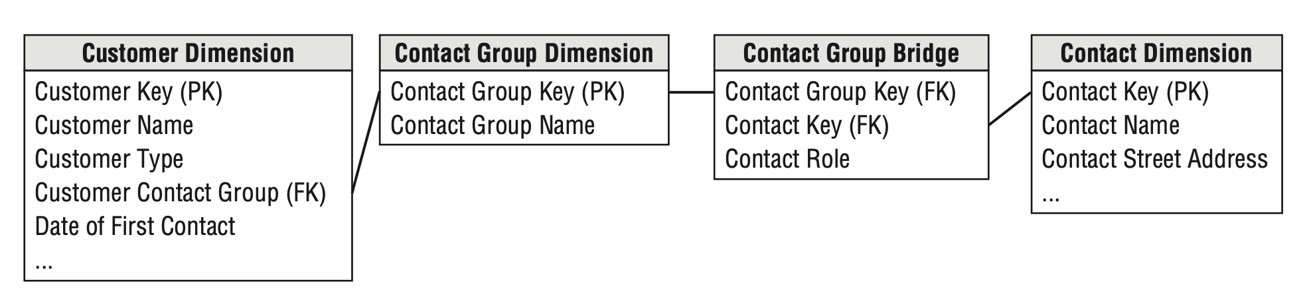
Bridge Table for Multiple Customer Contacts
Bridge tables can sit between fact and dimension tables, or alternatively, between a dimension table and its multivalued attributes (such as a customer and their hobbies or interests), in order to bring the grain of the fact table down to the grain of the dimension.

Slide 9
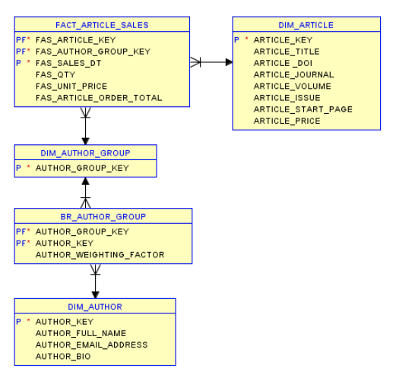
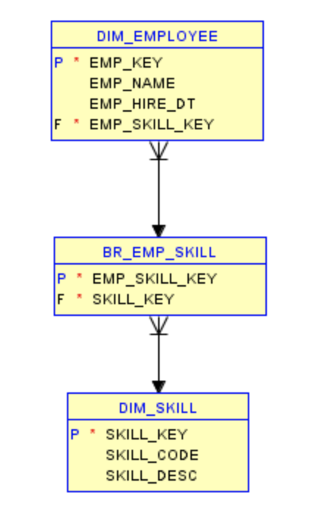
Bridge Table Cont.

Slide 10
Bridge Table Cont.

Slide 11
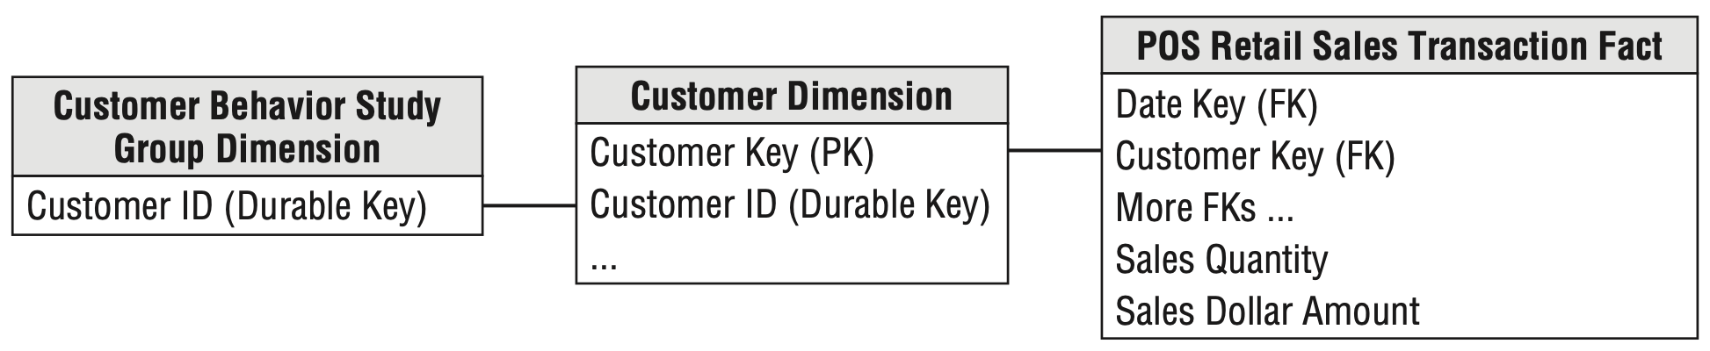
Behavior Study Groups for Cohorts
The set of customers from a query or exception report, called a behavior study group, for subsequent analyses without reprocessing to identify the initial condition.
the top 100 customers from last year, customers who spent more than $1,000 last month, or customers who received a specific test solicitation;

Slide 12
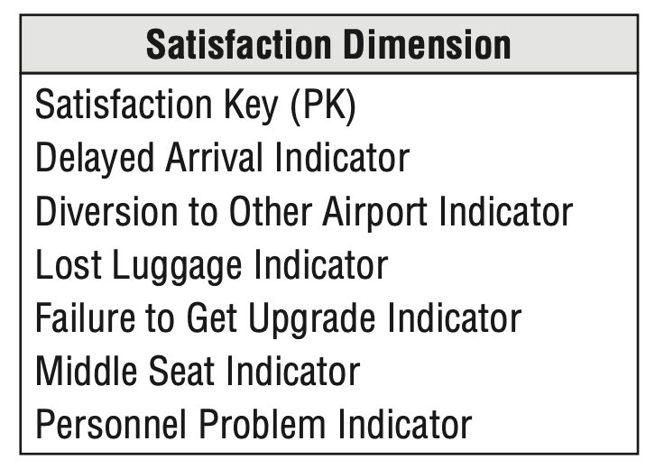
Tagging Fact Tables with Satisfaction Indicators
A frequent flyer satisfaction dimension that could be added to the flight activity fact tables;
Positional satisfaction dimension for airline frequent flyers:

